Slide 1
Querying Oracle with Excel Pivot Tables
Accessing Live Oracle Data with Excel Pivot Tables using Analytic Views
Bud Endress
<william.endress@oracle.com>

Slide 2
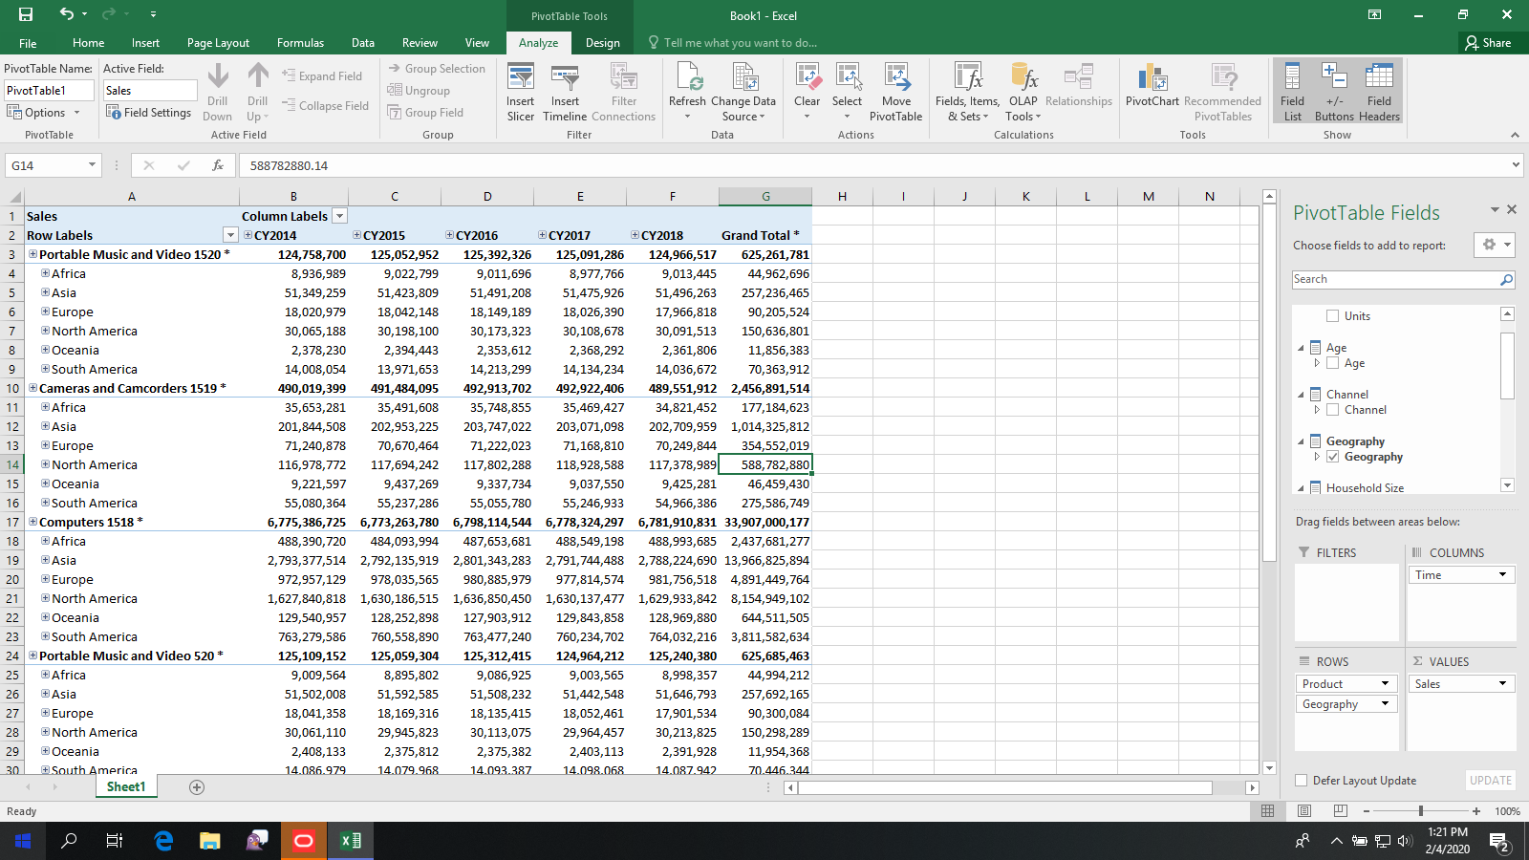
Key Concepts
Excel Pivot Tables provide a dimensional / hierarchical reporting experience (drill, pivot, detail and aggregate level data)
Excel Pivot Tables are native Excel functionality (that is, they are not add-ins)
Excel Pivot Tables can use data stored in Excel worksheets and access external, multidimensional data sources
Examples of multidimensional data sources include Microsoft Analysis Services and Oracle analytic views
Excel Pivot Tables query multidimensional data sources using an OLE DB for OLAP provider (Windows client software) and MDX (a multidimensional query language)

Slide 3
Excel Pivot Table querying live Oracle data
Hierarchy with drillable members
Hierarchy and measure selector
Selected hierarchies and layout manager

Slide 4
Accessing Oracle Data using Excel Pivot Tables
Excel Pivot Tables access multidimensional data sources
Oracle analytic views are multidimensional data sources
Includes hierarchical, measures and rich multidimensional metadata
Analytic views can be queried by SQL and MDX
Excel connects to multidimensional data sources using an OLE DB for OLAP provider
MDX language support is built into the Oracle Database
OLE DB for OLAP provider is Windows client connectivity software
No extra cost, included with every edition of the Oracle Database
Windows
Computer
Oracle OLE DB for OLAP Provider
Oracle ODBC Driver
Oracle Analytic Views
Oracle
Database
Oracle Tables

Slide 5
About Analytic Views
Analytic views are a feature of the Oracle database (every edition, no extra cost)
Analytic views layer a hierarchical / dimensional model over Oracle tables, views, etc.
Analytic views do not store data, they are a special type of view
As views, they do not require periodic maintenance (no ‘cube builds’ or updates)
Analytic views can be layered over a single table, star schema or snowflake schema
Analytic views act as multidimensional data sources to OLE DB for OLAP providers
Analytic views can be:
A simple, dimensional representation of Oracle table(s) for the purpose of acting as a multidimensional data source; or,
A rich, business model with hierarchies, aggregations, calculated measures and presentation metadata
Every analytic view can be queried with relational SQL, hierarchical SQL, MDX (OLE DB for OLAP provider) and REST Data Services

Slide 6
How to Use Excel Pivot Tables with Oracle Data
Install the Oracle OLE DB for OLAP Provider on your Windows PC
Configure TNSNAMES.ORA file with a database alias to your Oracle Database
Configure Oracle ODBC data source to connect to your Oracle Database
Create an analytic views
In Excel, create an Oracle OLE DB for OLAP connection to your Oracle Database
Create an Excel Pivot Table using the Oracle OLE DB for OLAP connection as the data source.

Slide 7
Installing OLE DB for OLAP Provider
OLE DB for OLAP provider is windows connectively software that connects to Oracle Database and accesses data in analytic views
OLE DB for OLAP provider is installed as part of the Oracle Data Access Components (ODAC) for Windows client installation
Requires Oracle 18c and ODAC 18c or later
ODAC is available in 32-bit and 64-bit additions
Use 32-bit ODAC with 32-bit Excel and 64-bit ODAC with 64-bit Excel
ODAC 32-bit downloads
ODAC 64-bit downloads
OUI (Oracle Universal Installer GUI) installs are easier than XCopy installs

Slide 8
Installing OLE DB for OLAP Provider
Download and unzip ODAC
Run Setup
Choose Windows account (Windows Built-in Account works in all (or at least most) cases

Slide 9
Installing OLE DB for OLAP Provider
Choose a location to install (the default location is usually good)

Slide 10
Installing OLE DB for OLAP Provider
Choose Oracle Provider for OLE DB for OLAP
Continue with installation
Note: The Oracle ODBC driver (required by the Oracle OLE DB for OLAP provider) is automatically installed.

Slide 11
Add Database Connection to TNSNAMES.ORA file
TNSNAMES.ORA will typically be installed into a directory such as c:\app\client\JACKSTRAW\18.0.0\client_1\Network\Admin
Add connection as appropriate, for example
sales_database = (DESCRIPTION = (ADDRESS = (PROTOCOL = TCP)(HOST = acme.com)(PORT = 1521)) (CONNECT_DATA = (SERVER = DEDICATED) (SID = orcl) ) )
Connection information will be specific to your database. Contact your Oracle database administrator for your connection information.

Slide 12
Run Windows ODBC Administrator Application
Choose 32 or 64 bit to match your ODAC installation
Add a new Data Source

Slide 13
Configure ODBC Driver
Name of the ODBC Connection (anything you like)
Choose your Oracle client
Database Alias in TNSNAMES.ORA file
Database owner / schema that owns the analytic view

Slide 14
Configure Data Source in Excel
Data tab
From Other Sources
From Data Connection Wizard
Other/Advanced

Slide 15
Configure Data Source in Excel
ODBC Data Source name
Oracle User Name and Password *
OLAP Provider for OLE DB
* Saving the password with the connection is optional

Slide 16
Configure Data Source in Excel
Connection file name (saved on PC)
Optionally, save password
Choose Oracle Analytic View

Slide 17
Configure Data Source in Excel
Data sources are saved as files here

Slide 18
Using a Data Source
Data tab
Existing Connections
Choose Data Source

Slide 19
Using a Data Source
Anchor position for PivotTable
Choose document type

Slide 20
Using a Data Source
Field Selector (select and move to areas below)
New PivotTable

Slide 21
Using a Data Source
Selected Fields
PivotTable

